Slide 1
Build and Release Management
Continues Integration and continues Delivery/Deployment
<Madhu>
<Assistant Manager>
<September, 2019>

Slide 2
Agenda
Release Management.
Devops Process with CI/CD Process.
Devops Tools with CI/CD.
Jenkins Configuration with third party tools.
Scripted Pipeline & Declarative Pipeline Process.
Master Slave/Node Mechanism.
© Integra.

Slide 3
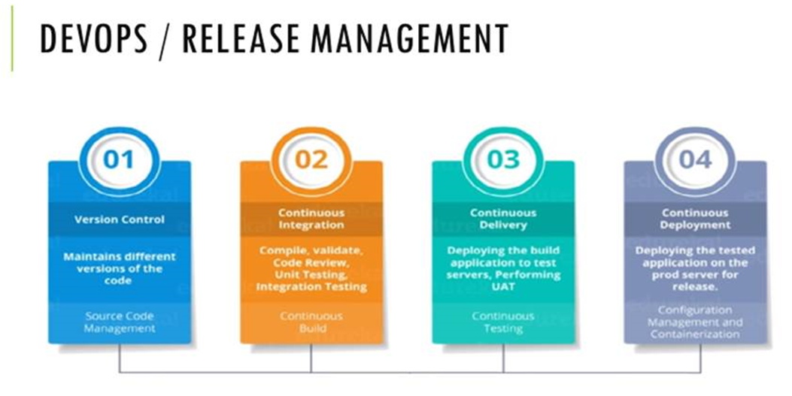
© Integra.

Slide 4
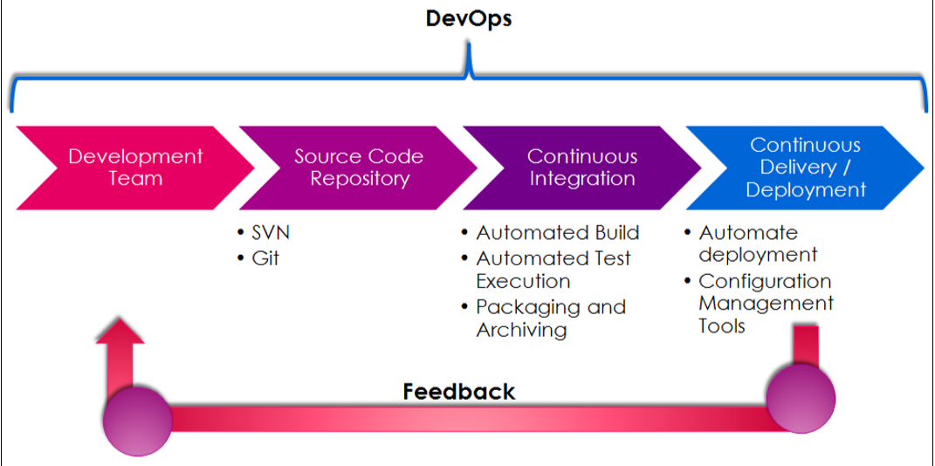
Devops Life Cycle
© Integra.

Slide 5
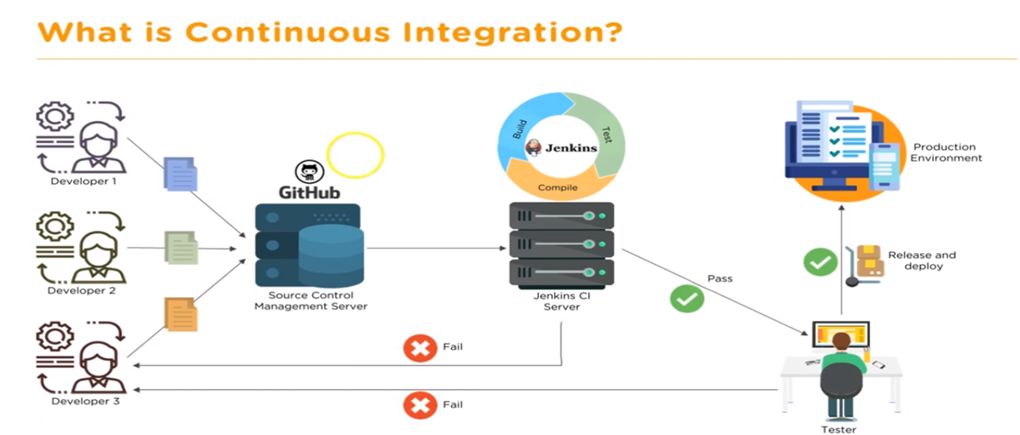
Continuous Integration – setting up the stage for a DevOps culture
© Integra.

Slide 6
Over view of Jenkins
Kohsuke Kawaguchi is a computer programmer who is best known as the creator of the Jenkins software project.
Jenkins is an open source application written in Java. It is one of the most popular continuous integration (CI) tools used to build and test different kinds of projects. we will have a quick overview of Jenkins, essential features, and its impact on DevOps culture. Before we can start using Jenkins, we need to install it. Installing Jenkins is a very easy task and is different from the OS flavors. We will also learn the basic configuration of Jenkins. We will take a quick tour of some key sections of the Jenkins UI and plugin installations as well. We will also cover the DevOps pipeline and how the rest of the chapters will cover implementing it.
© Integra.

Slide 7
CI/CD Tools
Git hub, Maven, Jenkins and Docker
        Web Application
        Tomcat, J-boss, WebSphere
        Nagios-Monitoring Tool
        Artifactory Tools
        Nexus and s3 bucket
© Integra.

Slide 8
Introduction to Jenkins and its features
Let's first understand what continuous integration is.
CI is one of the most popular application development practices in recent times. Developers integrate bug fix, new feature development, or innovative functionality in code repository.
The CI tool verifies the integration process with an automated build and automated test execution to detect issues with the current source of an application, and provide quick feedback.
© Integra.

Slide 9
Features of Jenkins is one of the most popular CI servers in the market:
• Easy installation on different operating systems.
• Easy upgrades—Jenkins has very speedy release cycles.
• Simple and easy-to-use user interface.
• Easily extensible with the use of third-party plugins—over 1000 plugins.
• Easy to configure the setup environment in the user interface. It is also possible to customize the user interface based on likings.
• The master slave architecture supports distributed builds to reduce loads on the CI server.
• Jenkins is available with test harness built around JUnit; test results are available in graphical and tabular forms.
• Build scheduling based on the cron expression (to know more about cron, visit http://en.wikipedia.org/wiki/Cron).
• Shell and Windows command execution in prebuild steps.
• Notification support related to the build status.
© Integra.

Slide 10
Installation of Jenkins on Windows and Linux(CentOS/Ubuntu)
Installation of Jenkins on Windows and CentOS
Go to https://jenkins-ci.org/. Find the Download Jenkins section on the home page of Jenkins's website.
Download the war file or native packages based on your operating system. A Java installation is needed to run Jenkins.
Install Java based on your operating system and set the JAVA_HOME environment variable accordingly.
© Integra.

Slide 11
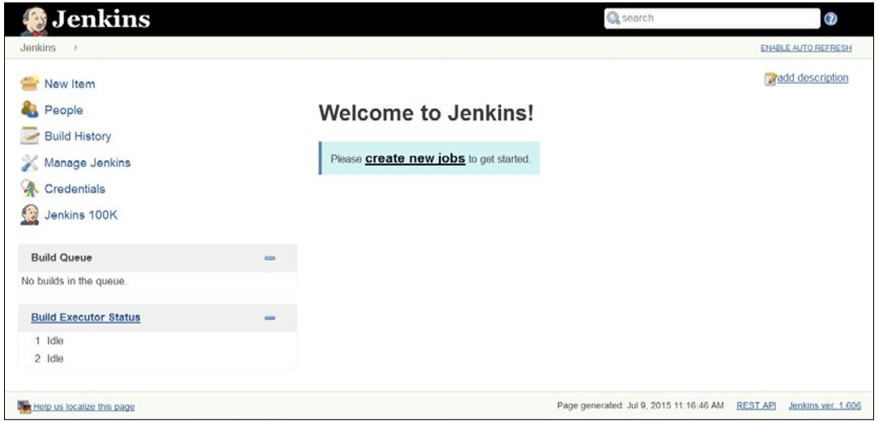
Jenkins Home page
© Integra.

Slide 12
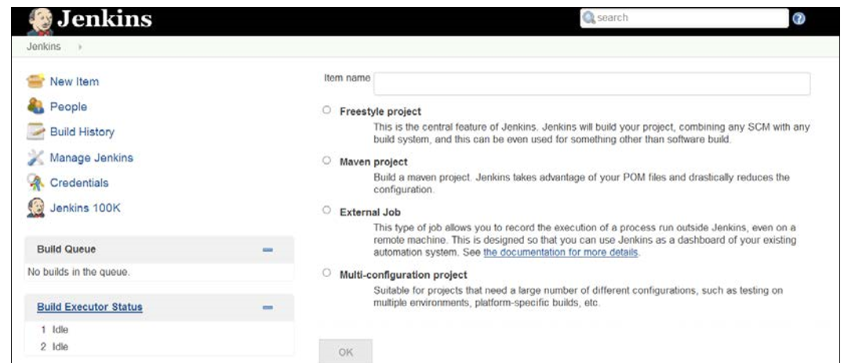
On the Jenkins dashboard, click on Create new jobs or on New Item to create Freestyle- CI.
© Integra.

Slide 13
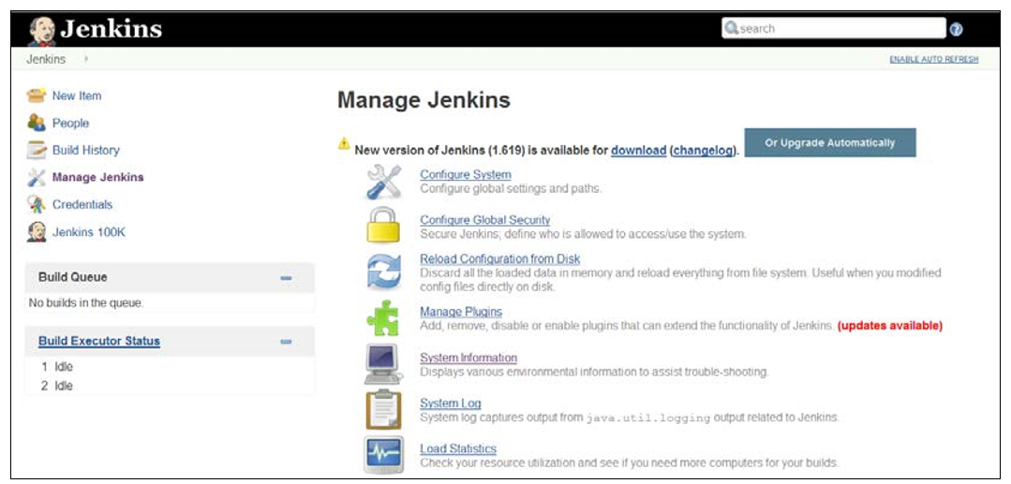
How to change configuration settings in Jenkins
© Integra.

Slide 14
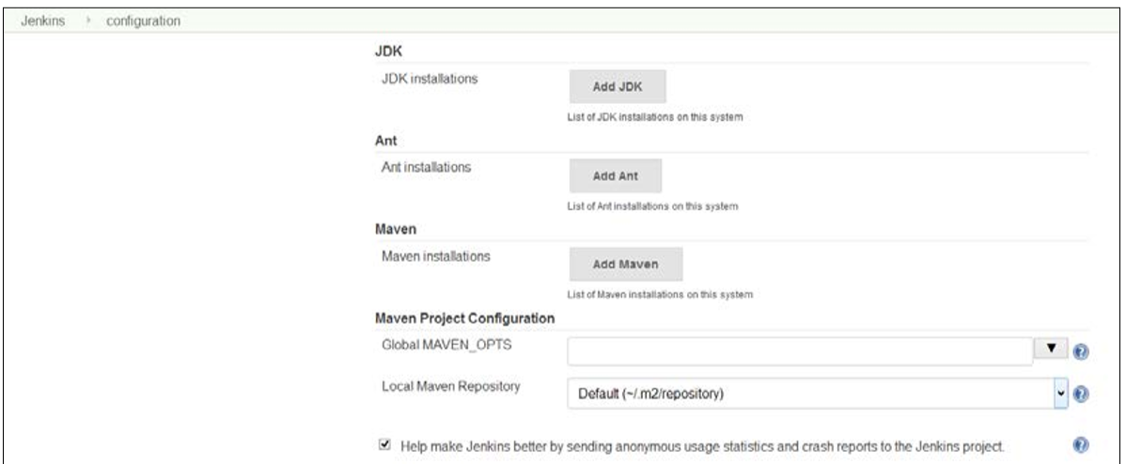
Configure System link to configure Java, Ant, Maven, and other third-party products' related information.
© Integra.

Slide 15
What is the deployment pipeline?
The application development life cycle is a traditionally lengthy and a manual process. In addition, it requires effective collaboration between development and operations teams. The deployment pipeline is a demonstration of automation involved in the application development life cycle containing the automated build execution and test execution, notification to the stakeholder, and deployment in different runtime environments. Effectively, the deployment pipeline is a combination of CI and continuous delivery, and hence is a part of DevOps practices. The following diagram depicts the deployment pipeline process:
© Integra.

Slide 16

  Not every change is a release
  Build software so that it can be rapidly & safely deployed to production by delivering every change to a production-like environment
  Ensuring business applications and services function as expected through rigorous automated testing
  Manual trigger of deployment when business is ready
  Every change is proven to be deployable at any time
  Continuous Delivery = Continuous Integration +
  fully automated test suite
© Integra.

Slide 17
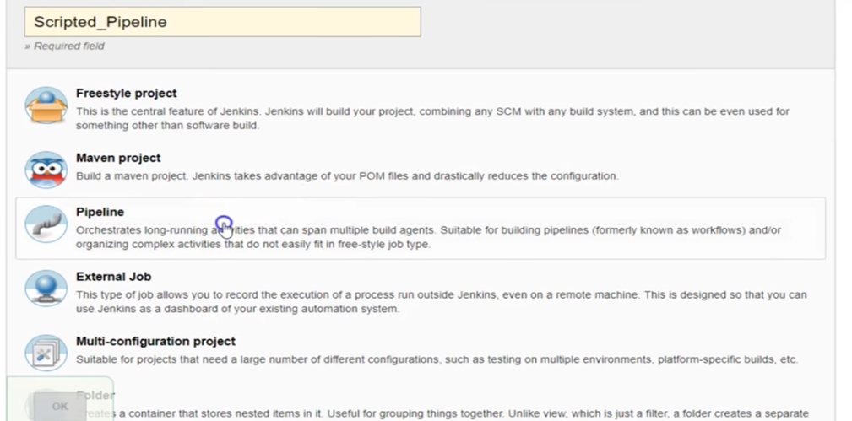
Scripted Pipeline and Declarative Pipeline
© Integra.

Slide 18
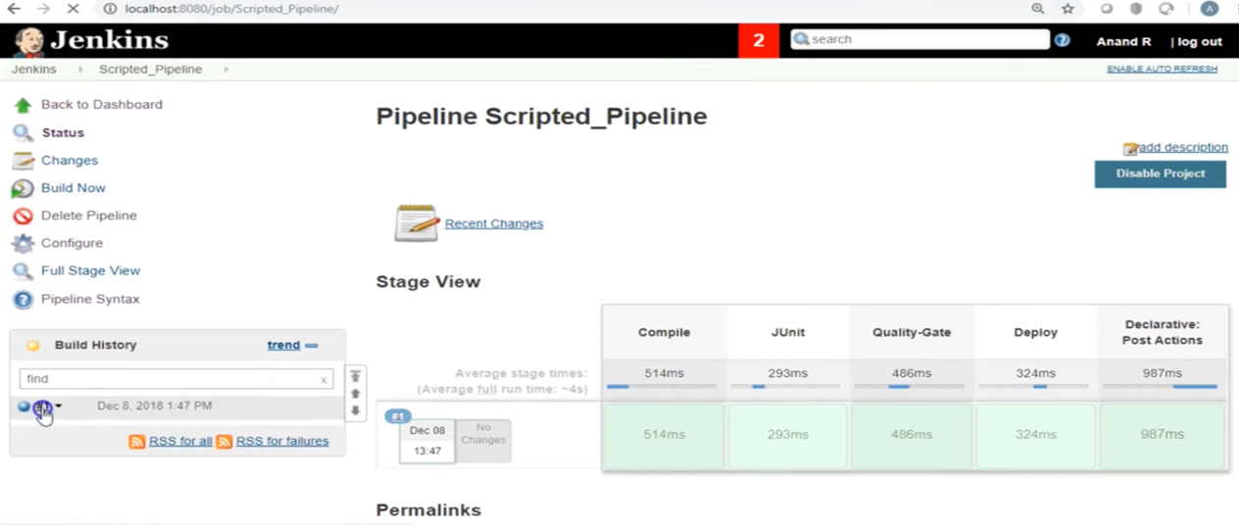
Pipeline Process step by step
© Integra.

Slide 19
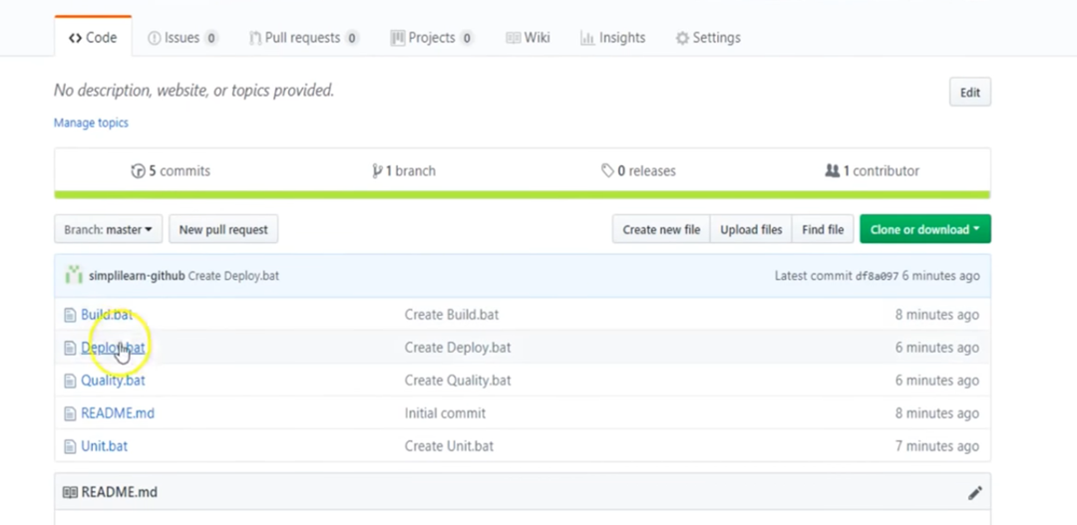
Source Code from Github Repository
© Integra.

Slide 20
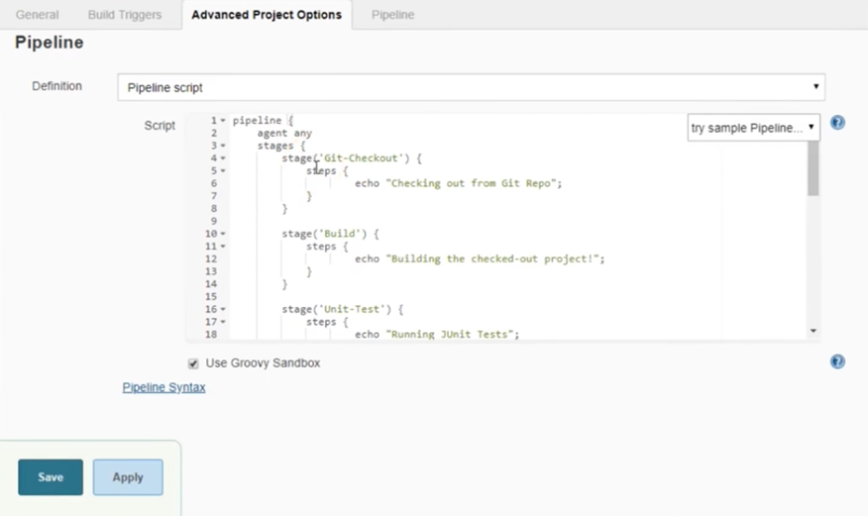
Declarative Pipeline with Groovy Script
© Integra.

Slide 21
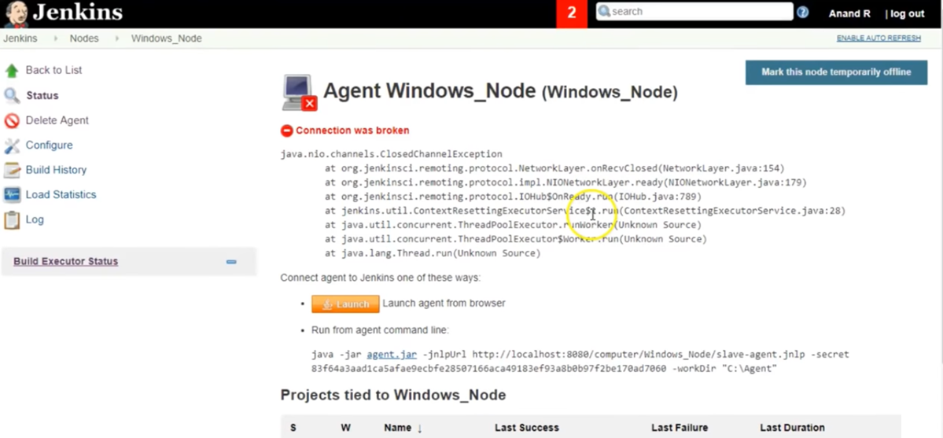
Master slave/Node Concepts
© Integra.

Slide 22
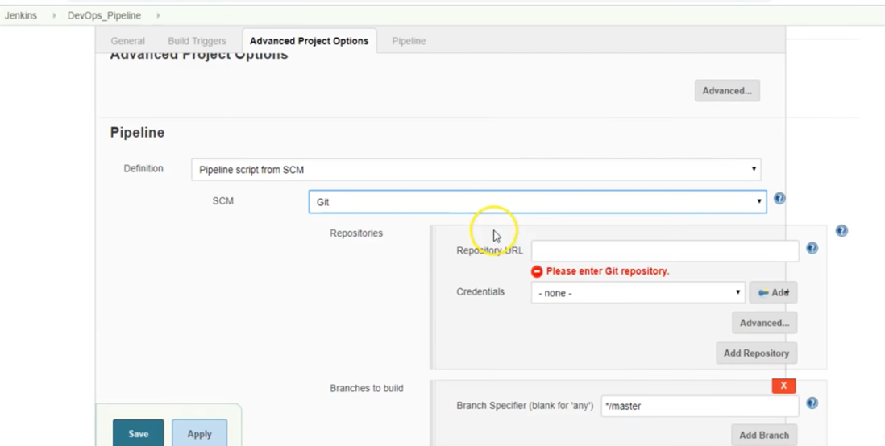
Declarative Pipeline-Jenkinsfile
© Integra.

Slide 23
Popular Plugins
Parameterized plugin
Pre SCM Build step plugin
Job configuration History Plugin
Build failure analyzer
Nested View plugin
Matrix Authorization strategy plugin
Build-timeout plugin
Throttle concurrent builds plugin
Build pipeline plugin
© Integra.

